Slide 1
Legal Disclaimer
PBSA hosts global industry leading speakers and subject matter experts as a course of current practice for our Education Webinars. The information and opinions expressed are for educational purposes only and are based on current practice, industry related knowledge and business expertise. The information provided shall not be construed as legal advice, express or implied. The practices may not have been independently vetted and are neither approved nor endorsed by PBSA.

Slide 2
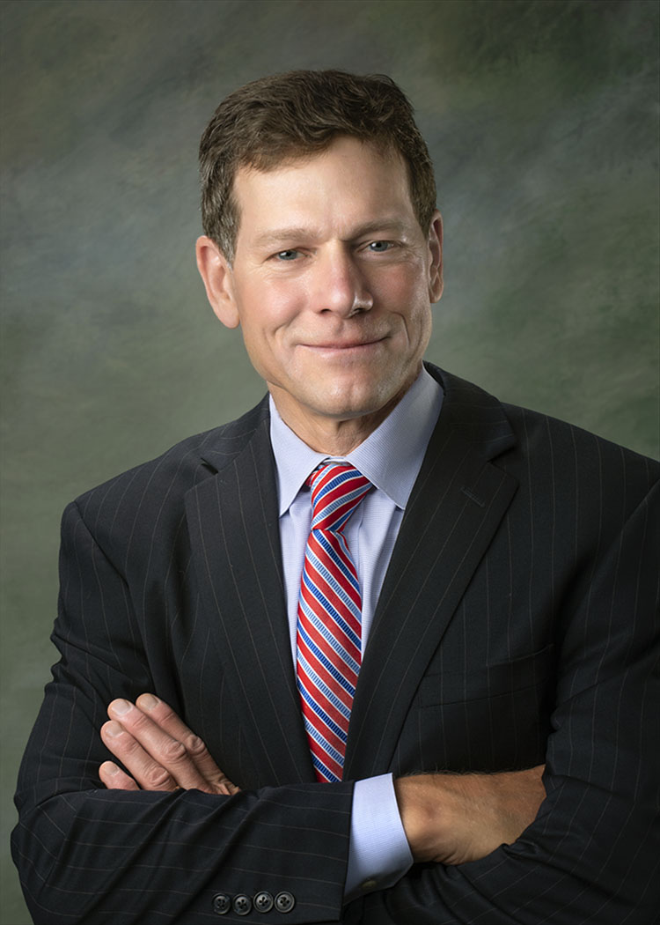

Why You Need an FCRA Compliance
Manual and What It Should Include
December 14, 2022
Joseph S. Messer
Messer Strickler Burnette, Ltd.
Sponsored by

Slide 3
The Number of FCRA Lawsuits Continues to Rise
In 2020, 5223 FCRA lawsuits were filed in the U.S., an increase of 5.3% over 2019. ¹
In 2021, 5406 FCRA lawsuits were filed, an increase of 3.5% over 2020.²
As of October 31, 2022, 4,735 FCRA lawsuits had been filed, an increase of 4.3% over the same period last year.³
FCRA lawsuits have been consistently outpacing FDCPA and TCPA lawsuits.

Slide 4
The Fair Credit Reporting Act
For Credit Reporting Agencies (CRAs) The Fair Credit Reporting Act (FCRA) is all about “reasonable procedures” for compliance. That term appears in the FCRA fifteen times, starting with:
“It is the purpose of this title to require that [CRAs] adopt reasonable procedures for meeting the needs of commerce for consumer credit, personnel, insurance, and other information in a manner which is fair and equitable to the consumer, with regard to the confidentiality, accuracy, relevancy, and proper utilization of such information in accordance with the requirements of this title.” (15 U.S.C. § 1681(b))

Slide 5
FCRA Not Strict Liability, but….
The FCRA is not a “strict liability” statute. However, burden shifting provisions make it difficult for CRAs who lack “reasonable procedures” to avoid liability.
For example, 1681(a) prohibits CRAs from issuing an investigative consumer report unless consumer disclosures are made, and 1681(b) requires CRAs to give the consumer written disclosure of the “nature and scope of the investigation” within a specified period of time.

Slide 6
FCRA Not Strict Liability, but….
However, 1681d(c) provides CRAs who violated 1681d(a) or (b) a defense if they have a “reasonable procedure” for compliance:
“No person may be held liable for any violation of subsection (a) or (b)…if he shows by a preponderance of the evidence that at the time of the violation he maintained reasonable procedures to assure compliance with subsection (a) or (b)…”
A CRA without “reasonable procedures” lacks defense.

Slide 7
1681d(4) Reasonable Procedures
1681d(4) also governs CRAs who issue investigative consumer reports:
“A [CRA] shall not prepare or furnish an investigative consumer report on a consumer that contains information that is adverse to the interest of the consumer and that is obtained through a personal interview with a neighbor, friend, or associate of the consumer or with another person with whom the consumer is acquainted or who has knowledge of such item of information, unless
  the [CRA] has followed reasonable procedures to obtain confirmation of the information from an additional source that has independent and direct knowledge of the information; or
  the person interviewed is the best possible source of the information.”

Slide 8
1681e(a) Reasonable Procedures
1681e(a) requires CRAs to have “reasonable procedures” for (i) ensuring their reports do not contain information prohibited from being reported; and (ii) furnishing reports
to only those with “permissible purpose.”

Slide 9
1681e(a) Reasonable Procedures
1681e(a) specifies what these reasonable procedures are:
“These procedures shall require that prospective users…identify themselves, certify the purposes for which the information is sought, and certify that the information will be used for no other purpose.

Slide 10
1681e (e)(2)(A)+(B) Reasonable Procedures
1681e(e)(2)(A) and (B) governs CRAs who resell reports or information issued by other CRAs (e.g., TransUnion, Equifax or Experian). Those CRAs must:
“establish and comply with reasonable procedures designed to ensure that the report (or information) is resold by the [CRA] only for a purpose for which the report may be furnished under … 1681b…, including by requiring that each person to which the report (or information) is resold and that resells or provides the report (or information) to any other person
identifies each end user of the resold report (or information);
certifies each purpose for which the report (or information) will be used; and
certifies that the report (or information) will be used for no other purpose; and
(B) Before reselling the report, make reasonable efforts to verify the identifications and certifications made under subparagraph (A).

Slide 11
1681e(b) Reasonable Procedure
1681e(b) is the basis for most lawsuits against CRAs:
“Whenever a [CRA] prepares a consumer report it shall follow reasonable procedures to assure maximum possible accuracy of the information concerning the individual about whom the report relates.”

Slide 12
1681e(b) Reasonable Procedure
But 1681e(b) does not tell CRAs what “reasonable procedures” they must follow to ensure the “maximum possible accuracy” of their reports.
So, what “reasonable procedures” does a CRA need to avoid 1681e(b) liability?

Slide 13
1681i(a) Reinvestigation
1681i(a) requires a CRA to conduct a reinvestigation after receiving a consumer disputes states in part:
“…if the completeness or accuracy of any item of information contained in a consumer’s file...is disputed by the consumer…the CRA shall…conduct a reasonable reinvestigation to determine whether the disputed information is inaccurate and record the current status of the disputed information, or delete the item…”

Slide 14
1681i(a)(5)(c) Reasonable Procedures
1681i(a)(5)(C) states:
“A [CRA] shall maintain reasonable procedures designed to prevent the reappearance in a consumer’s file, and in consumer reports on the consumer, of information that is deleted [due to a reinvestigation].”

Slide 15
1681k(a) “Strict Procedures”
1681k(a) imposes a “strict procedures” requirement on CRAs who issue reports for employment:
“A [CRA] which furnishes a consumer report for employment purposes and which for that purpose complies and reports items of information on consumers which are matters of public record and are likely to have an adverse effect upon a consumer’s ability to obtain employment shall
at the time such public record information is reported to the user of such consumer report, notify the consumer of the fact that public record information is being reported by the [CRA], together with the name and address of the person to whom such information is being reported; or
maintain strict procedures designed to ensure that whenever public record information which is likely to have an adverse effect on a consumer’s ability to obtain employment is reported it is complete and up to date.

Slide 16
Must They Be In Writing?
The FCRA does not require CRAs to put their procedures in writing.
But how can a CRA prove it has “reasonable procedures” if they are not in writing?

Slide 17
Why They Should Be In Writing
REQUEST NO. 5: Produce all documents that set forth the policies and procedures that You rely upon to prepare consumer reports while assuring maximum possible accuracy of consumers’ criminal history information.
Discovery request in lawsuits alleging CRA violated 1681e(b).

Slide 18
Why They Should Be In Writing
Without written 1681e(b) compliance procedures it becomes difficult to defend the lawsuit.
Defense will depend on the vagaries of witnesses’ understanding of how things are supposed to be done.
Unless witness can adequately testify, they will be ineffective in demonstrating that the company has procedures to assure its “maximum possible accuracy”.

Slide 19
FCRA Compliance Manuals
CRAs who include their procedures in FCRA Compliance Manuals are well-suited to defend FCRA lawsuits.
Putting procedures in writing establishes much of the defense and can often make the difference between winning or losing (or settling for big money).

Slide 20
Procedure Can Overcome Liability
Black v. Gen. Info. Sols. LLC ⁴ the researcher failed to read the entire court docket and as a result erroneously recorded a robbery conviction. The CRA’s procedure was to review the entire docket including the full docket of any transferee court. If the researcher had followed this procedure the report would have been accurate.
No Liability: “The failure of one individual investigator to follow established procedures, whether due to misinterpretation of the information available, or negligence in following through, is not sufficient to create liability against the background check company. [The CRA] maintained strict, multi-layered procedures designed to ensure that its reporting of criminal histories was complete, up to date, and as accurate as possible.”

Slide 21
Black v. Gen. Info. Sols. LLC
No Liability: “[The CRA] requires all employees to undergo yearly FCRA training and have other training programs in effect to ensure employees are educated in FCRA compliance. [The CRA] also has procedures and policies in place to assess the quality of its reports, … to track disputes and errors, and to improve internal processes as needed based on the information gained from these other procedures.”

Slide 22
Taylor v. Selection Management Systems, Inc.⁵
Taylor’s report contained a drug trafficking conviction that belonged to someone else.
No Liability: “[The CRA] maintains a FCRA Compliance Manual which describes its processes and procedures …. [It] trains its employees pursuant to the manual and conducts quarterly audits of its employees' work. When an employee is searching criminal records, [the CRA] requires each criminal record to be verified by two identifies, including name, date of birth, address, driver's license, and social security number. The employee must also include a case number, file date, disposition date, statement of charge, and disposition of the criminal case. The employee must contact the court if any of the information cannot be verified. If the criminal record cannot be verified with a reasonable degree of certainty, it is excluded from the report.”

Slide 23
Contents of Your FCRA Compliance Manual
If you issue investigative consumer reports, procedures for complying with 1681d(a) (b) and 1681d(4):
  Consumer disclosure & disclosure of "nature & scope of investigation".
  Person interviewed has independent & direct knowledge of information.
Procedures for complying with 1681e(a):
  Reports may not contain prohibited info (7-year limit) and may be furnished to only those with permissible purpose.
Procedures for complying with 1681e(a) (and 1681e(e)(2)(A)&(B) if you are a reseller):
  Reports resold to only those with permissible purpose;
  Requiring those to whom reports are resold to (i) identify end user; (ii) certify purpose; & (iii) certify report will be used for no other purpose
  Reasonable efforts to verify these identifications & certifications.

Slide 24
Contents of Your FCRA Compliance Manual
Procedures for complying with 1681e(b): Assuring the maximum possible accuracy of the information in your reports.
Procedures for conducting "reasonable investigations" under 1681i(a) and to prevent the reappearance of deleted information under 1681i(a)(5)(C)
If you issue employment reports, your 1681k(a)(2) "strict procedures" unless you notify consumers pursuant to 1681k(a)(1).

Slide 25
Considerations 1681e(b) Accuracy Procedures
Your 1681e(b) procedures for assuring the maximum possible accuracy of reports should include:
  Standards for matching records to the consumer:
    Types of personal identifiers to consider
    Number of personal identifiers required for a match.
    Other considerations before matching such as common names, incomplete birth dates, age of identifiers & conflicting information such as photos.

Slide 26
Considerations 1681e(b) Accuracy Procedures (cont.)
  Standards for Properly Classifying Crimes in Reports:
    Rules for properly categorizing records as “felony”, “misdemeanor”, “traffic”, “infraction”, and classifications for records (e.g., “Petty”, “aggravated”, “gross”, 1, 2 ,3 or A, B, C, misdemeanor).
    Rules for determining if crimes have been downgraded (e.g. felony to misdemeanor)
    Rules for reporting parole and probation violations.
  Procedures for Situations Where Records are Unclear or Conflicting:
    Rules for consulting supervisors rather than making unilateral determinations.
    Rules for how long to proceed when determinations cannot be made with certainty.

Slide 27
Considerations 1681i(a) Reinvestigation Procedures
Your 1681i(a) procedures for reinvestigating consumer disputes should include:
  Procedures for Determining if a Dispute has occurred:
    Specification of departments or personnel responsible for fielding oral and written disputes.
    Instructions on differentiating between consumer inquiries and disputes.
  Procedures for Responding to Third Party Disputes:
    Rules for ensuring 3rd party is authorized to act for the consumer.
    Rules regarding consumer consent to provide report or file to the 3rd party.
  Procedures for Determining the Scope of a Reinvestigation:
    Instructions on how to determine exactly what the consumer is disputing.

Slide 28
Considerations 1681i(a) Reinvestigation Procedures (cont.):
  Responsibility for Conducting Reinvestigations:
    Specifying departments & personnel responsible for fielding & conducting reinvestigations.
    Rules for providing dispute information to the appropriate department & personnel.
  Standards for Conducting Reinvestigations:
    Specifying for proper reinvestigations.
    Rules for treatment of inaccurate or unverifiable records.
    Rules for completing reinvestigations within the time required under the FCRA.

Slide 29
Recommend 1681i(a) Reinvestigation Procedures (cont.):
  Procedures for Responding to Frivolous or Irrelevant Disputes:
    Standards for determining if a consumer’s dispute is frivolous or irrelevant.
    Rules for treating a dispute as frivolous or irrelevant when consumer fails to provide sufficient information to reinvestigate.
    Rules for notifying the consumer within 5 days of making the determination, including the reason for the determination.
  Procedures for Reinsertion of Previously Deleted Records:
    Rules regarding requirement that furnisher of removed information certify it is complete and accurate.
    Rules regarding written notice to consumer of reinsertion within 5 business days of the information being reported.

Slide 30
Recommend 1681i(a) Reinvestigation Procedures (cont.)
  Procedures for Notifying Consumers of Results of Reinvestigation:
    Rules for providing written notice to consumers of reinvestigation results within 5 business days after reinvestigation completion.
    Instructions for contents of and enclosure to notice.
    Rules for providing notice of outcome of reinvestigation to customer who received report upon request by the consumer.
  Procedures for Continued Disputes:
    Rules regarding consumer’s right to file statement if the dispute is not resolved to their satisfaction.
    Procedures for limiting statement to 100 words and providing assistance to the consumer for writing a clear summary of the dispute.
    Procedures for including the consumer’s statement in subsequent reports containing the disputed information.

Slide 31
Other Recommended Provisions for Your
FCRA Compliance Manual:
Procedures for responding to consumer requests for reports and/or files:
  Instructions for determining whether the consumer has requested their report of their file.
  Instructions for requiring that consumer provide proper identification before responding.
Rules and Procedures for Complying with State-Specific Credit & Criminal Reporting Laws
Rules and Procedures for Complying with Municipal Credit & Criminal Reporting Laws
Employee Training Procedures
Compliance Audit Procedures

Slide 32
About the Speaker
For more information on FCRA compliance, contact Joseph Messer at:
jmesser@messerstrickler.com
(312) 334-3440
Mr. Messer provides comprehensive legal representation to CRAs and related companies throughout the nation in litigation, compliance and transactional matters. A former Illinois Special Assistant Attorney General, Mr. Messer has extensive trial and appellate experience and is admitted to practice before many federal district courts. He has earned a national reputation for defending lawsuits brought under the FCRA and other consumer protection laws.
He has conducted many trials and has substantial class action experience. Mr. Messer is a nationally recognized author and speaker and an active member of the Professional Background Screeners Association.

Slide 33
Sources
[1] https://webrecon.com/webrecon-stats-for-dec-2020-and-year-in-review/
[2] https://webrecon.com/webrecon-stats-for-dec-2020-and-year-in-review/
[3] Case No. 1:15 CV 1731 (N.D. Ohio Feb 26, 2018).
[4] Case No. 1:18-cv-224 (S.D. Ohio Jan. 27, 2021).

